Slide 1
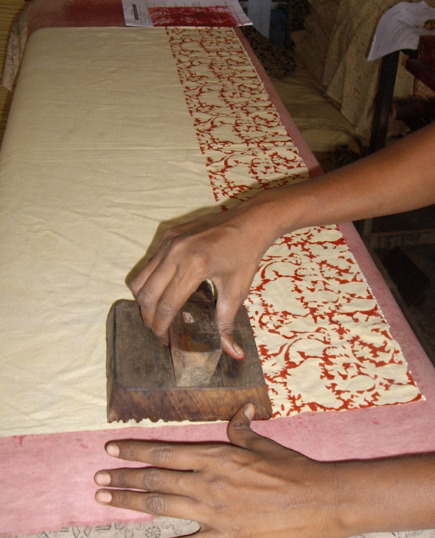
Kalamkari
Accessories & Jewelry

Slide 2
Kalamkari
Kalamkari is the art of painting cotton fabrics with a kalam (literally kalam means pen and kari, art), a sharp pointed bamboo stick padded with hair or cotton and tied with a string on one end to regulate the flow of color. Vegetable dyes only are used to color the designs applied on cloth. The art of painting using organic dyes on cloth is popular in several parts of India. Since the 17th century these fabrics were exported to Iran, Siam, Burma, and the Persian Gulf, then they knew an huge success in Europe, the fabrics being used for bedspreads and furnishing.
Once painted, the fabric is dipped in Myrobalam, a solution of milk and water that makes the dye permanent. The fat holds the colors on the surface and prevents them from spreading. Then the starch from the fabric is cleared in river water.
Baladarshan orders a range of products made out kalamkari from different producers groups in South India, especially groups of socially marginalized women (widows, destitute, HIV affected, physically challenged women).
Kalamkari fabric is also available in bulk, please contact us for any information.

Slide 3
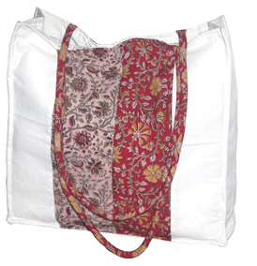
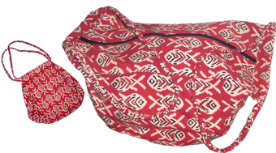
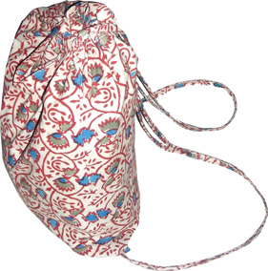
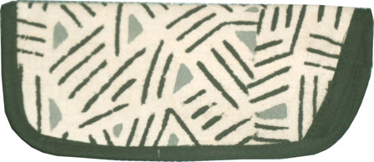
Kalamkari
Bag Mathy
Ref: TA01
Dim: 40 x 40 x 12 cm
Weight: 300 g
Material: Cotton, kalamkari
Bag Shakthi
Ref: TA02
Dim: 36 x 36 x 39cm
Weight: 270 g
Material: Cotton, kalamkari
Bag Ganesh (Set of 10)
Ref: TA03
Dim: 45 x 35 cm
Weight: 250 g (Set)
Material: Cotton, kalamkari
Spectacle cases (Set of 10)
Ref: TA04
Dim: 17x 7.5 cm
Material: Cotton, kalamkari

Slide 4
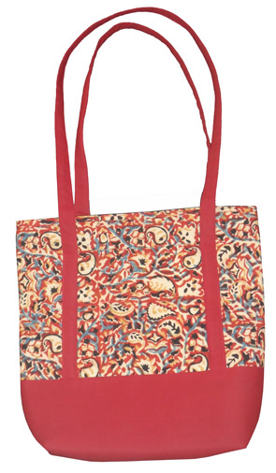
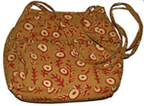
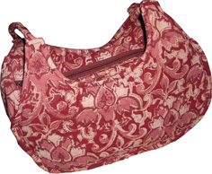
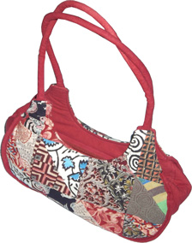
Kalamkari
Bag Amudha
Ref: TA05
Dim: 35 x 35 x 10 cm
Material: Cotton, kalamkari
Hand-bag Devi
Ref: TA06
Dim: 25 x 22 x 8 cm
Weight: 140 g
Material: Cotton, kalamkari
Boat bag
Ref: TA07
Dim: 30 x 22 cm
Weight: 120 g
Material: Cotton, kalamkari
Boat bag patchwork
Ref: TA08
Dim: 30 x 22 cm
Weight: 140 g
Material: Cotton, kalamkari

Slide 5
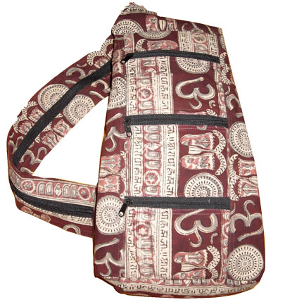
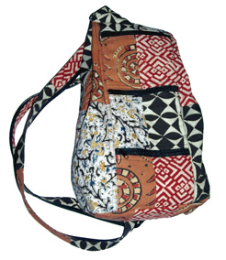
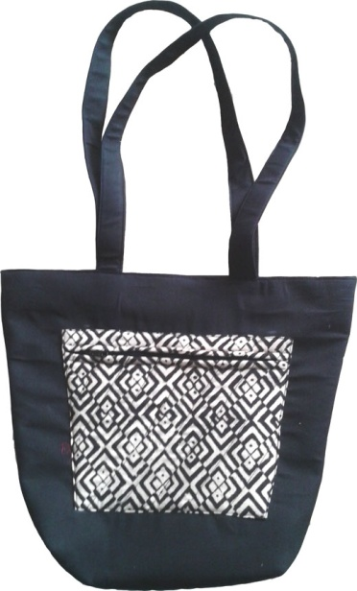
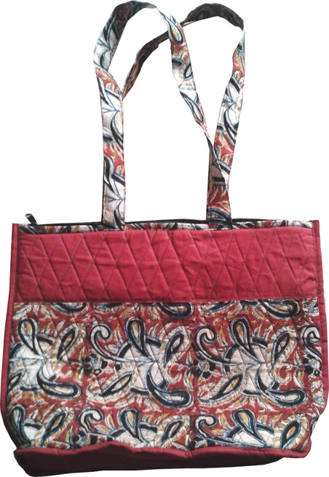
Kalamkari
Traveler back-bag
Ref: TA09A
Dim: 45 x 21 x 11 cm
Weight: 200 g
Material: Cotton, kalamkari
Traveler patchwork back-bag
Ref: TA09A
Dim: 45 x 21 x 11 cm
Weight: 240 g
Material: Cotton, kalamkari
Bag Indira
Ref: TA10
Dim: 38 x 33 cm
Material: Cotton, kalamkari
Quilted shopping bag
Ref: TA11
Dim: 43 x 33 cm
Material: Cotton, kalamkari

Slide 6
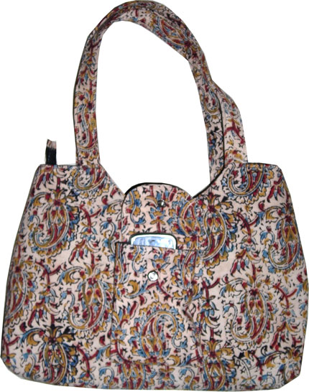
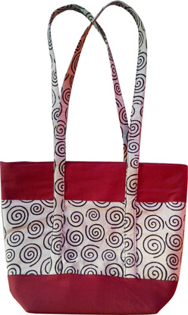
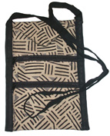
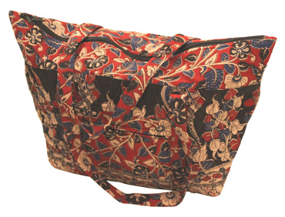
Kalamkari
Bag Sarala
Ref: TA12
Dim: 33 x 26 cm
Material: Cotton, kalamkari
Bag Manjula
Ref: TA13
Dim: 40 x 40 x 8 cm
Weight: 240 g
Material: Cotton, kalamkari, EVA inner lining
Flight ticket pouch
Ref: TA14
Dim: 24 x 17 cm
Weight : 60 g
Material: Cotton, kalamkari
Veera bag
Ref: TA15
Dim: 58 x 38 x 15 cm
Material: Cotton, kalamkari

Slide 7
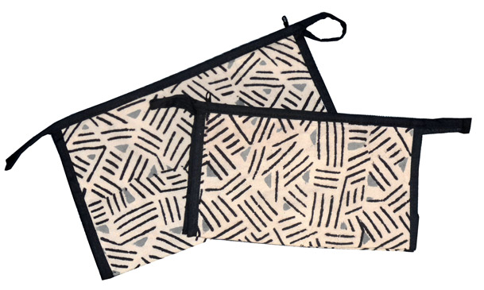
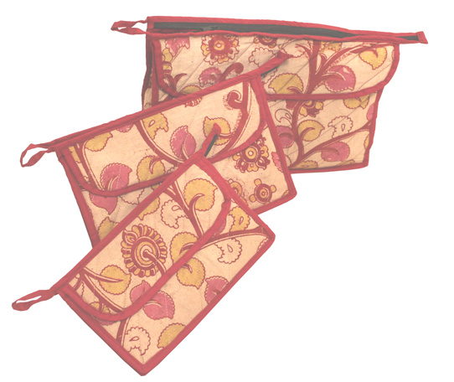
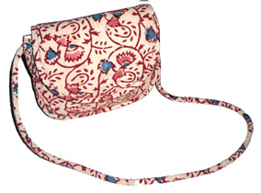
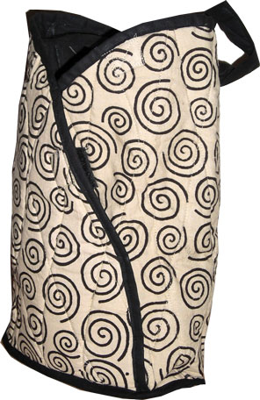
Kalamkari
Toilet kit – Set of 2
Ref: TA16
Dim: 24 x 15 x 9 cm
Material: Cotton, kalamkari, EVA lining
Toilet kit Suseela – Set of 3
Ref: TA17
Dim: 30 x 18 x 7 cm / 24 x 16 x 7 cm / 21 x 13 x 7 cm
Material: Cotton, kalamkari
Bag Vani
Ref: TA18
Dim: 22 x 18 cm
Weight : 80 g
Material: Cotton, kalamkari
Bag Dora
Ref: TA19
Dim: 33 x 28 x 11 cm
Weight : 100 g
Material: Cotton, kalamkari

Slide 8
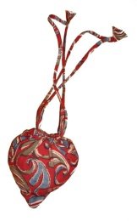
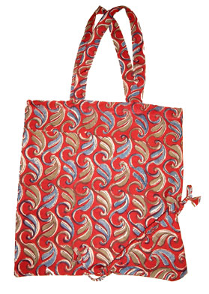
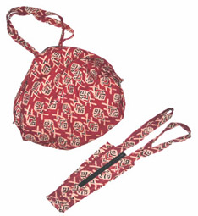
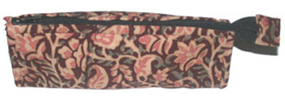
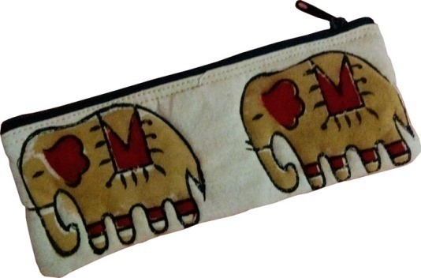
Kalamkari
Heart bag
Ref: TA20
Dim: 38 x 36 cm
Weight : 60 g
Material: Cotton, kalamkari, EVA lining
Bag Ram
Ref: TA21
Dim: 58 x 38 x 7 cm
Weight : 110 g
Material: Cotton, kalamkari
Pencils case (Set of 10)
Ref: TA22
Dim: 20 x 7 x 6 cm
Weight : 500 g (Set)
Material: Cotton, kalamkari
Elephants Patchwork pencils case (Set of 10)
Ref: TA23
Dim: 20 x 8 cm
Material: Cotton, kalamkari

Slide 9
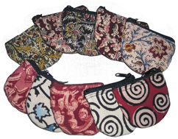
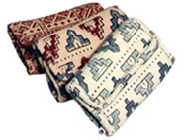
Kalamkari
Coins purses (Set of 10)
Ref: TA24
Dim: 8 x 7 cm
Weight: 60 g (Set)
Material: Cotton, kalamkari
Money purses (Set of 10)
Ref: TA25
Dim: 12x 8 cm
Weight: 300 g (Set)
Material: Cotton, kalamkari

Slide 10
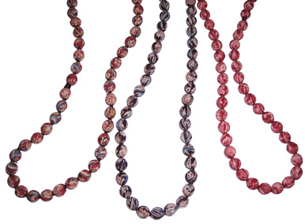
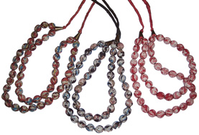
Kalamkarijewelry
Small beads necklace (set of 10)
Ref: IRKJ01
Dim: 80 cm
Weight: 500 g (Set)
Material: kalamkari, beads
Double beads necklace (set of 10)
Ref: IRKJ02
Dim: 72 cm
Weight: 500 g (Set)
Material: kalamkari, beads

Slide 11
CONTACT:
BALADARSHAN
“Arivu”
245, Sathyavani Muthu Nagar
Pallavan Salai
Chennai 600 002
India
Tel: +91 (0)44 64 57 03 88
balafairtrade@gmail.com
www.baladarshan.com

